Slide 1
Introduction to Serverless Computing
March 28, 2019 — 8:30 AM - 5:00 PM | Detroit, Michigan
Learn, architect, and develop solutions on Azure
#AzureDevDays
for developers, by developers
Learn.
Connect.
Explore.

Slide 2
Azure Platform

Slide 3






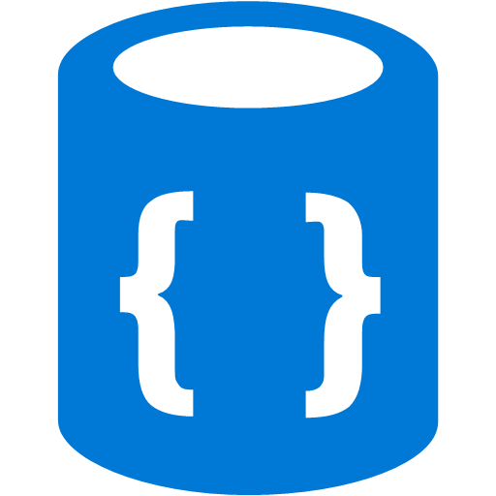
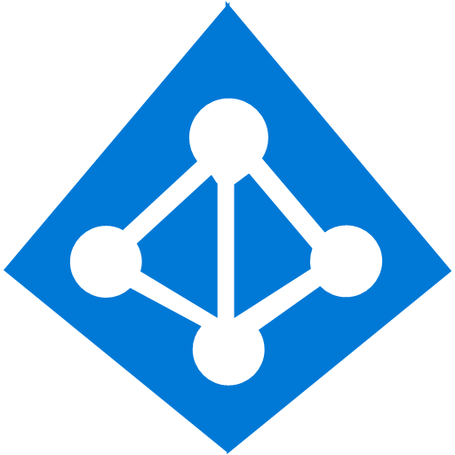





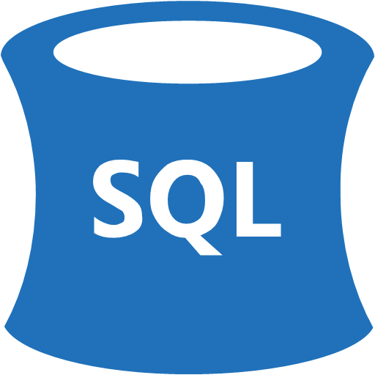


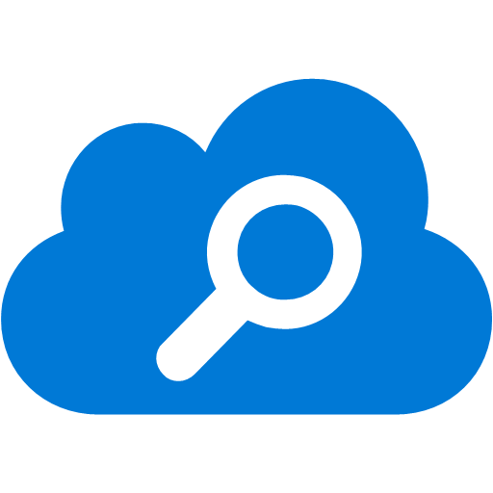
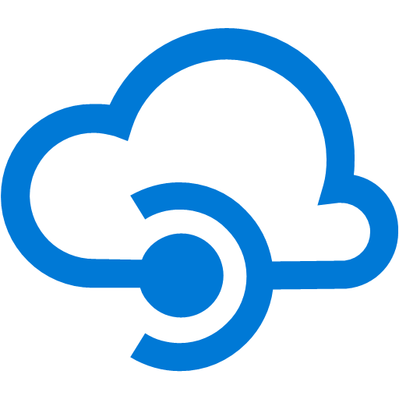
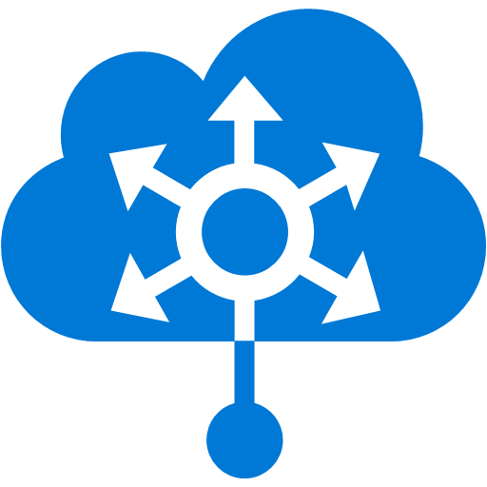


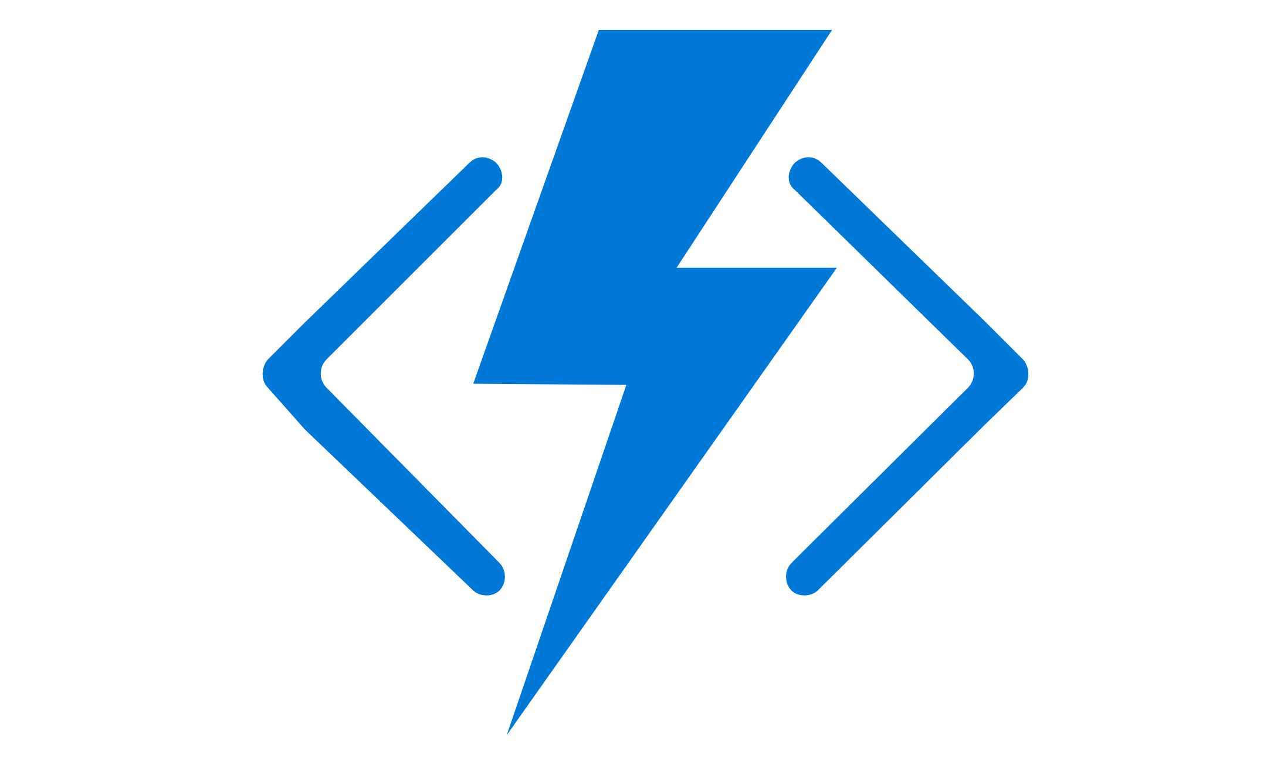
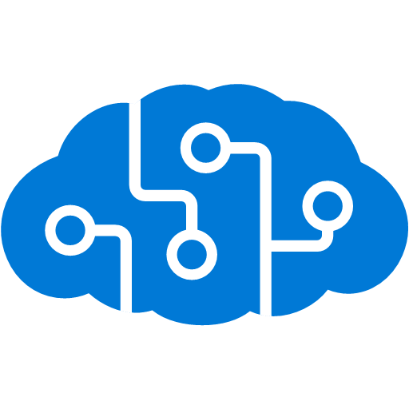


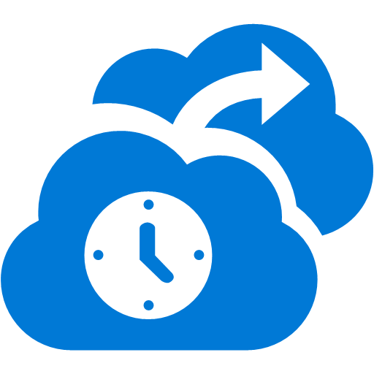

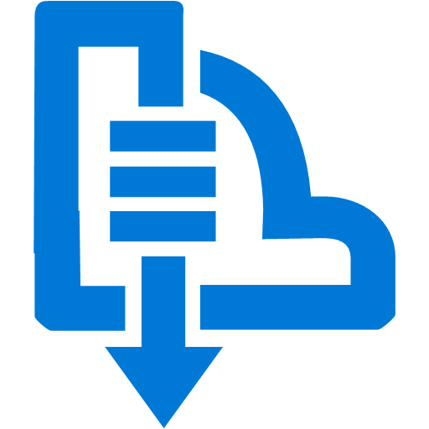

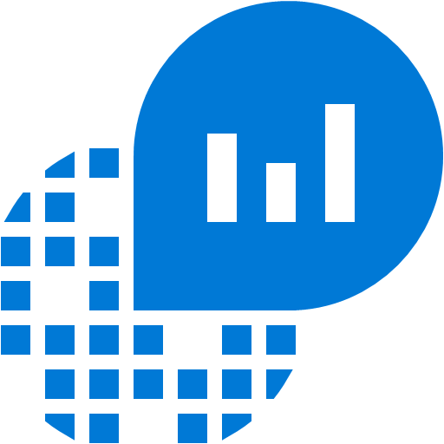
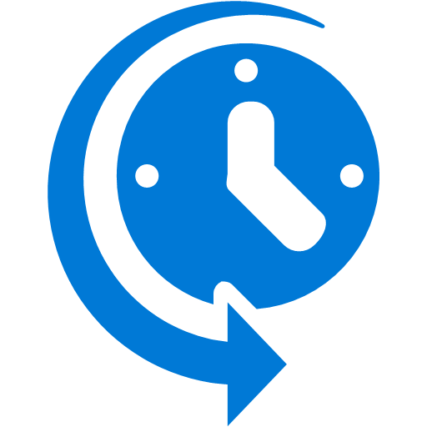



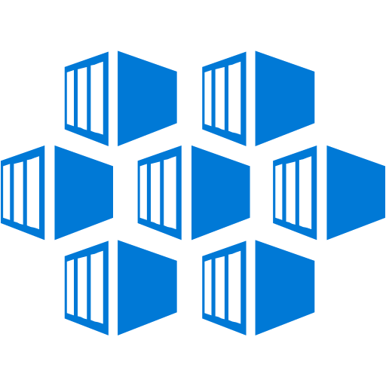

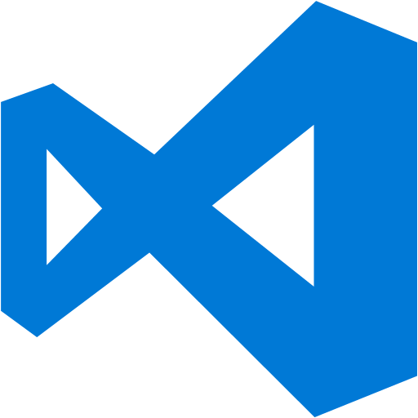

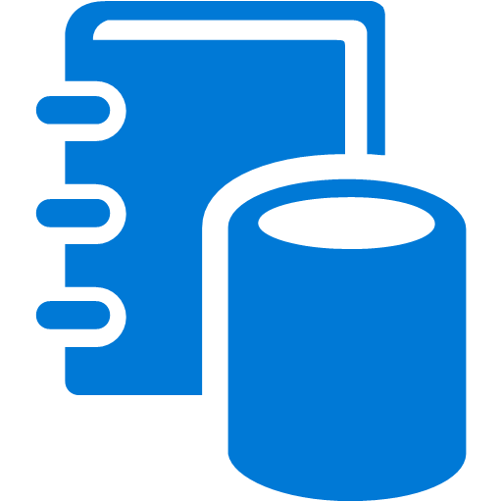


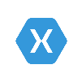


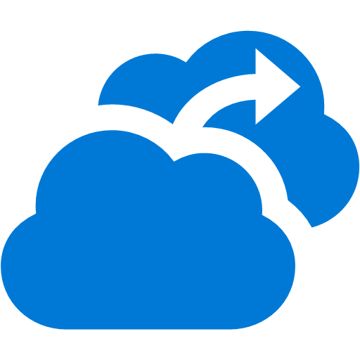


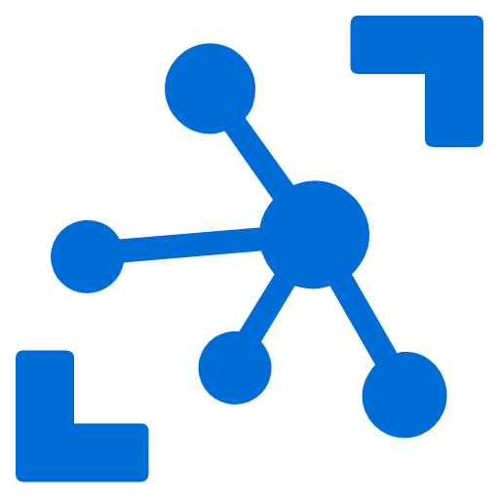
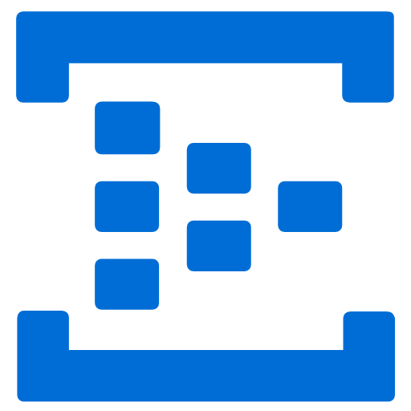


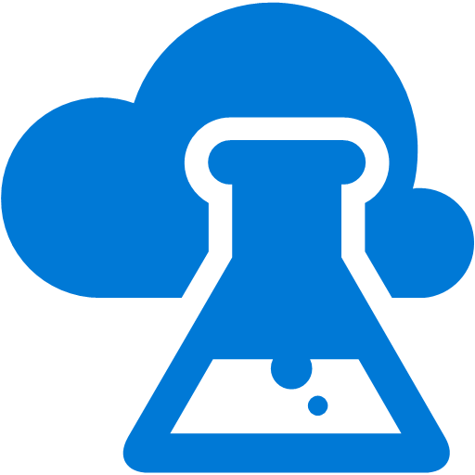





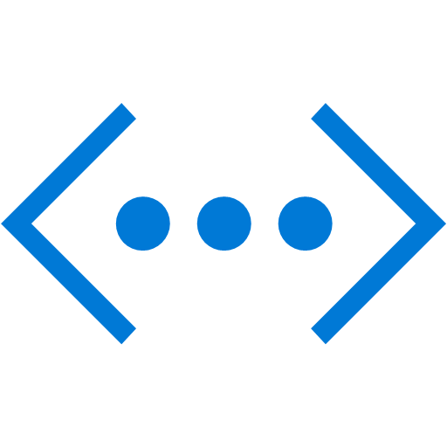
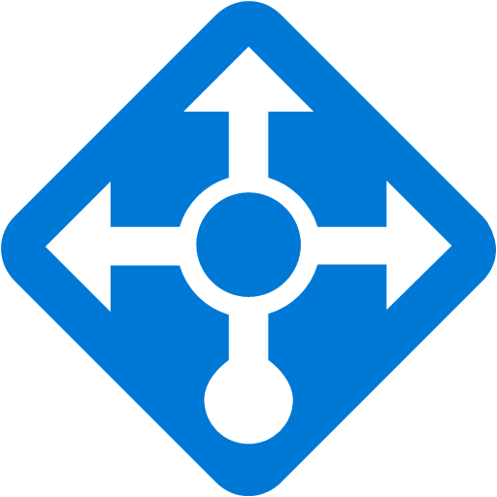
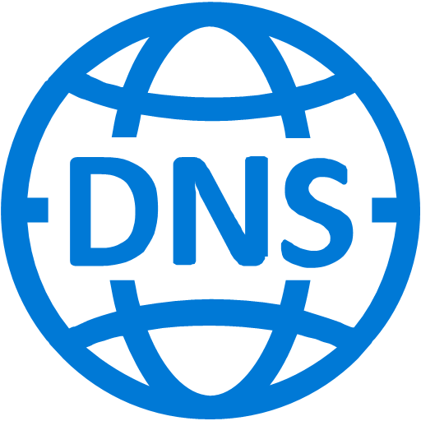
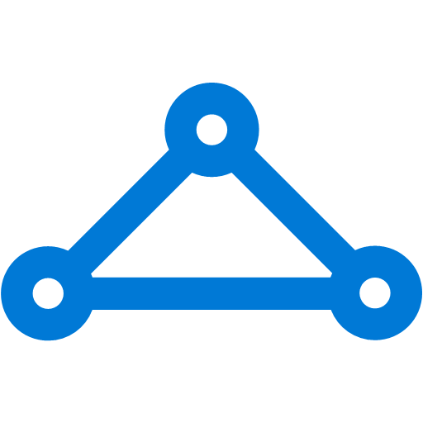



Platform Services
Security & Management
Hybrid
Cloud
Media & CDN
Application Platform
Data
Security Center
Media Services
Media Analytics
Content Delivery
Network
Mobile
Apps
SQL
Database
SQL Data
Warehouse
DocumentDB
Azure AD
Health Monitoring
Web
Apps
Portal
Integration
SQL Server
Stretch Database
Redis
Cache
Storage
Tables
AD Privileged
Identity
Management
Azure Active
Directory
API
Apps
Cloud
Services
Azure
Search
Azure AD
B2C
API
Management
BizTalk
Services
Intelligence
Domain Services
Service
Fabric
Notification
Hubs
Logic
Apps
Service Bus
Functions
Cognitive Services
Bot Framework
Cortana
Backup
Multi-Factor
Authentication
Developer Services
Analytics & IoT
Automation
Compute Services
Operational
Analytics
Scheduler
HDInsight
Machine
Learning
Stream Analytics
Container
Service
VM
Scale Sets
Visual Studio
Mobile
Engagement
Data
Catalog
Data Lake
Analytics Service
Import/Export
Key Vault
VS Team Services
Data Lake Store
Batch
RemoteApp
Xamarin
Azure Site
Recovery
Store/
Marketplace
IoT Hub
Event
Hubs
Data
Factory
Power BI
Embedded
Dev/Test Lab
Application
Insights
HockeyApp
VM Image Gallery
& VM Depot
StorSimple
Infrastructure Services
Compute
Storage
Networking
Virtual Machines
Containers
Blob
Queues
Files
Disks
Virtual Network
Load Balancer
DNS
Express
Route
Traffic Manager
VPN Gateway
App
Gateway
Datacenter Infrastructure
Notes:
Why this Slide:
It shows we have a very broad platform. It about BOTH IaaS and PaaS, that these work together. It shows that we continue to lead in world class IT capabilities and that there’s really nothing missing.
Key Points:
We have already seen how the Azure Platform is IaaS + Pass – but I want you to understand that this is a huge number of capabilities – IT building blocks if you will.
Every one of these blocks you provision anytime, self-service anywhere in the world 24x7. You pay for what you use, you can get more or less anytime and you can fully automate everything…
DON’T spent too much time on this slide – you are going to DEMO (aren’t you!!!)… DON’T go through each block…
Transition to NEXT Slide: Make the build go backwards to show JUST IaaS and then you will go to the demo to show it.

Slide 4
App Services

Slide 5
Collection of Cloud Services
Infrastructure-as-a Service
VMs, Storage, Networks, Dev/Test Labs
Platform-as-a Service
App Service, SQL Azure
Software-as-a Service
O365, Azure DevOps (VSTS), Cognitive Services

Slide 6
Azure App Service
Mobile Apps
Function Apps
Web Apps
API Apps
Logic Apps
Azure Service Fabric

Slide 7
Azure App Service

Slide 8
App Service: Web Apps
Traditional Webhosting
Hosting with Web Apps
App
App
Web App
Azure Service Fabric
Server + OS + Webserver (IIS)
Server + Azure OS + Webserver (IIS)

Slide 9
App Services: Web Apps
Host web applications
.NET, Node.js, Python, Java, PHP
SLA 99.95%
Custom Domains and SSL
Deployment Slots
Continuous Deployment
Scaling (Manual or Auto)
Authentication / Authorization
Traffic Mgmt
Access on-premise data
Integrated Monitoring w/ Application Insights
Load testing with Azure DevOps(VSTS)
Azure Web App

Slide 10




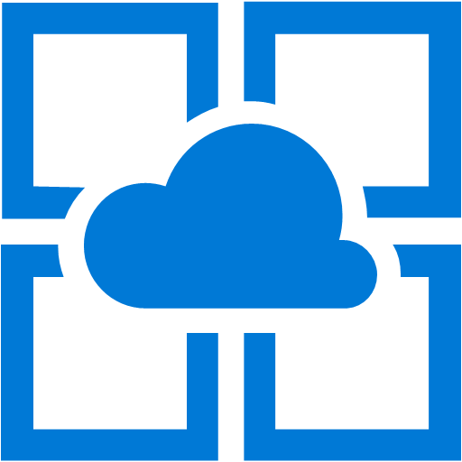
Industry-leading Application PaaS Platform
Solutions
Transactional
Apps
Digital
Marketing
LoB App
Modernization
Services
Web Apps
Web App for Containers
API Apps
Mobile Apps
IDE
Enterprise Integration
Serverless compute
Data /Storage
Intelligence
Application Insights
App Service
Platform
Fully Managed Platform • High Productivity Development • Enterprise Grade Apps
Notes:
When it comes to Azure PaaS there are many different ways to build & deploy your applications on Azure. Azure App Service , Service Fabric, Azure Functions, Azure Container Service, etc.
Our focus for today is Azure App Service.
Before we go in to what is App Service, lets look in to what types of Apps you can run.
Transactional Apps
Digital Marketing
LOB Apps
Now what is App Service?
It is a High productivity & Fully Managed Platform-as-a-Service offering from Microsoft
What kinds of Apps you can run App Service?
Your traditional Web Apps
Mobile Apps – i.e. Web Apps that are backend to Mobile App (some times people say App Service supports Mobile Apps, just to be clear we provide web app backend that plugs in to a client Mobile App)
API Apps – API Style Web App. These are just web apps, that don’t necessarily have human being clicking around in a browser
Web App for Containers – supports Docker containers to run web app, API App, mobile apps
Azure Functions –Technically it’s a different compute model offering, but it runs under App Service. From a developer standpoint functions is really a great way to introduce serverless event driven compute workload along side of apps running in App Service. It’s a natural fit to run some parts of the application in Functions and lot of it on App Services.
Logic Apps - Logic Apps provide a way to simplify and implement scalable integrations and workflows in the cloud. It also offers many connectors across the cloud and on-premises to quickly integrate across services and protocol. Logic Apps are beyond the scope for this presentation and it will be covered in a separate session in the future.

Slide 11
The “evolution” of application platforms
On-Premises
IaaS
PaaS
Serverless
Notes:
To understand what Serverless is and how it fits into the landscape let’s look at ta brief history of application platforms and the cloud…
Before the cloud everyone did things on-premises.
Then virtual machines were moved to the cloud with Infrastructure as a service or IaaS.
Following that applications started reducing VMs by taking advantage of managed platform services with Platform as a service or PaaS.
And finally there is a natural evolution to reduce infrastructure further with Serverless focusing on Functions as a service (FaaS) and Messaging as a service (MaaS).

Slide 12
Before cloud
What is the right size of
servers for my business needs?
How do I deploy new code to my server?
What media should I
use to keep backup?
What happens in case of
server hardware failure?
Which packages should be on my server?
What size of servers
should I buy?
Who monitors
my App?
How often should I backup my server?
How can I scale my app?
How can I increase server utilization?
Who has physical
access to my servers?
Which OS should I use?
Do I need secondary network connection?
Are my server in a
secure location?
What happens if the
power goes out?
Who monitors
my Servers?
Do I need a UPS?
What storage I need to use?
How many servers
do I need?
How can I dynamically configure my app?
It takes how long to provision a new server?
How often should
I patch my servers?
Notes:
Note to speaker: no extra clicks needed, all visuals will fly in on their own at page load time.
Before the cloud if you were a successful who needed to build business apps you would have to go buy (or rent) servers and infrastructure to run your apps.
With that came many things to consider. What servers to buy, how to provision new servers, what to do if there is hardware failure, how to deploy code and patch my servers. And many more.
Unless you were an IT business none of these considerations contribute to your core business of banking, selling, consulting etc.

Slide 13
Then IaaS reduced friction for digital business
What is the right size of servers for my business needs?
How can I increase server utilization?
How many servers do I need?
How can I scale my app?
How often should I patch my servers?
How do I deploy new code to my server?
How often should I backup my server?
Which OS should I use?
Which packages should be on my server?
Who monitors my App?
Notes:
Note to speaker: no extra clicks needed
A few years later came the cloud with something called “IaaS” or Infrastructure as a Service.
The idea is, you don’t need to buy or build your own servers and instead you use the infrastructure service in the cloud.
This allows you not to worry about things like provisioning physical servers and securing the location of your data center.
Many of the previous concerns go away but you still need to think about which operating system to use and how to patch servers, in addition to managing your business apps.

Slide 14
Then PaaS removed a lot of infrastructure ops
What is the right size of “servers” for my business needs?
How can I increase “server” utilization?
How many “servers” do I need?
How can I scale my app?
Notes:
The next category of services the cloud offers are called “PaaS” or Platform as a service.
What is great about this is that server patching, operating system selection, back up and code deployment are all built into the platform.
Many of the previous concerns with IaaS go away but you still need to think about what server capacity you need, how to increase your server utilization and plan for scaling of your apps.

Slide 15
Now Serverless lets us focus on our apps
How do I architect my app to become Serverless?
Notes:
Finally we arrive at the emerging category of cloud services called “Serverless”.
Once way of understanding serverless is to look at it as a platform providing a further abstraction of servers and infrastructure than PaaS.
No more provisioning and management of infrastructure, no more up front planning for capacity and scale, just a focus on the code needed for your apps.

Slide 16

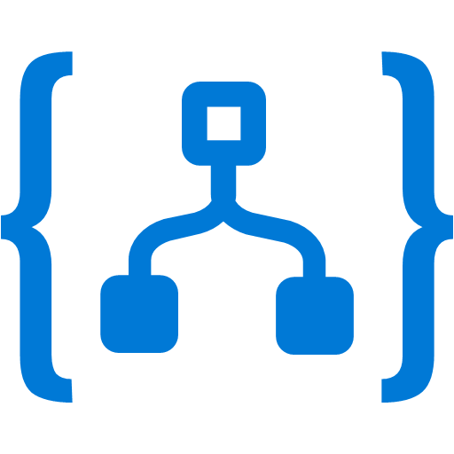
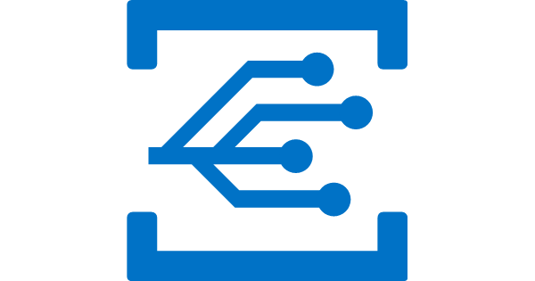
Microsoft Serverless services
Functions
Logic Apps
Event Grid
Serverless compute
Serverless workflow
Serverless events
Notes:
Zooming in on the 3 primary Azure Serverless services.

Slide 17


What is serverless?
Full abstraction of servers
Developers can just focus on their code—there are no distractions around server management, capacity planning, or availability.
Instant, event-driven scalability
Application components react to events and triggers in near real-time with virtually unlimited scalability; compute resources are used as needed.
Pay-per-use
Only pay for what you use: billing is typically calculated on the number of function calls, code execution time, and memory used.*
*Supporting services, like storage and networking, may be charged separately.

Slide 18
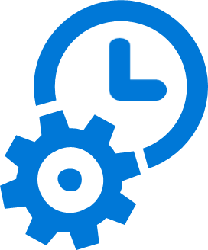
What are the benefits?
Solve business problems—not technology problems related to undifferentiated heavy lifting
Focus
Shorter time to market
Fixed costs converted to variable costs
Better service stability
Better development and testing management
Less waste
Efficiency
Simplified starting experience
Easier pivoting means more flexibility
Easier experimentation
Scale at your pace—don’t bet the farm on Day 1
Natural fit for microservices
Flexibility

Slide 19

Focus on code, not plumbing
No infrastructure management
Auto-scale based on your workload
No wasted resources, pay only for what you use

Slide 20

Sample scenarios for Functions
Web/Mobile app workloads
IoT-connected backends
Real-time processing
Automation of infrastructure

Slide 21


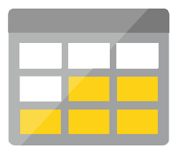
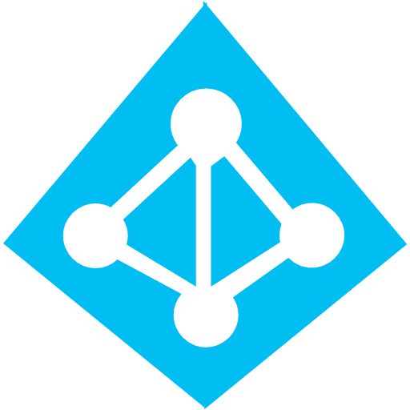
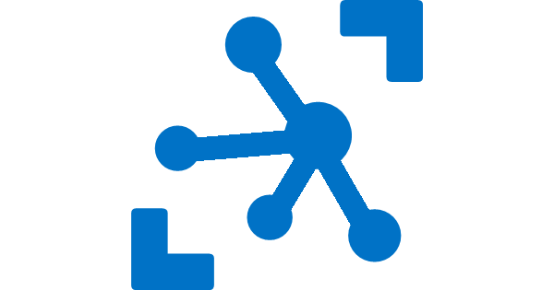
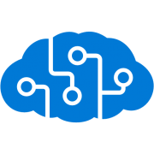
Full integration with Azure ecosystem
Development
Platform
IDE support
Functions
Logic Apps
Event Grid
Developer productivity
Triggers and Bindings
Flexible deployment options
Manage all events that can trigger code or logic
Visual designer
200+ connectors (e.g. Twitter, Blob storage)
Functions orchestration
Execute your code based on events you specify
Manage all events in one place
Near real-time delivery
Broad coverage
Design workflows and orchestrate processes
Integrated DevOps
Local development
Monitoring
Database
Storage
Security
IoT
Analytics
Intelligence
Visual Debug History
Notes:
Lets talk about what makes up Microsoft’s Serverless platform: At the center of the Serverless platform are Azure Functions, Azure Logic Apps and Azure Event Grid.
Azure Functions let’s you write a function in the language of your choice to respond to an event. For example you may want to process a file when it’s added to blob storage or send a notification email when the temperature of a connected fridge an event hub rises over a certain value.
Logic Apps let’s you orchestrate multiple built in and custom functions together using a visual workflow designer.
Azure Event Grid allows you to raise and manage events that your Functions and Logics Apps can respond to.
In addition to these serverless services your apps will likely use some supporting platform services like Cosmos DB or Storage to save state, IoT Hub to receive messages from connected devices or Cognitive Services to gain insights from messages, images or videos.
Finally your developers will also use tools like Visual Studio and services like Visual Studio Team Services to build, test and deploy your app.

Slide 22
What can you build with Serverless?
Anything that needs to respond to events
Serverless applications
Timer-based processing
Millions of devices feed into Stream Analytics
Transform to structured data
Store data in Cosmos DB
Every 15 minutes
Find and clean invalid data
Clean table
Real-time bot messaging
App backends
?
...
Message sent to Chatbot
Chatbot sends
response
Photo taken and WebHook called
Stores in blob storage
Produces scaled images
Cortana Analytics answers questions
Notes:
So what kind of apps and scenarios can be built using serverless technologies?
The answer is anything where there is need to run some logic in response to an event.
The above definition covers a big portion of the computing universe. Modern computing is all about events:
An IoT device sending data to analyze and store in real-time is an event. There are billions of those. Handling of such data such as enriching, analyzing or filtering is best done using serverless functions which can be spun up on demand.
Almost every web based application needs to run some regular maintenance task like cleaning up a database or synchronizing data between two systems. All of these times are events. Such tasks that need to be run only at specific times, don’t call for dedicated infrastructure. They are best left to serverless solutions.
A mobile app clicking a picture and submitting to backend is an event. There are billions of such apps. In many cases developers building such apps want to focus on delighting their customers using clients app experience. Serverless technology can easily take away the burden of building mobile backends.
Automated response systems receiving a customer request is an event. Building intelligent bots for such scenarios using serverless technology is again a great example where the focus needs to be on logic instead of infrastructure.
As you can see from these examples almost any application architecture can benefit from implementing serverless.

Slide 23
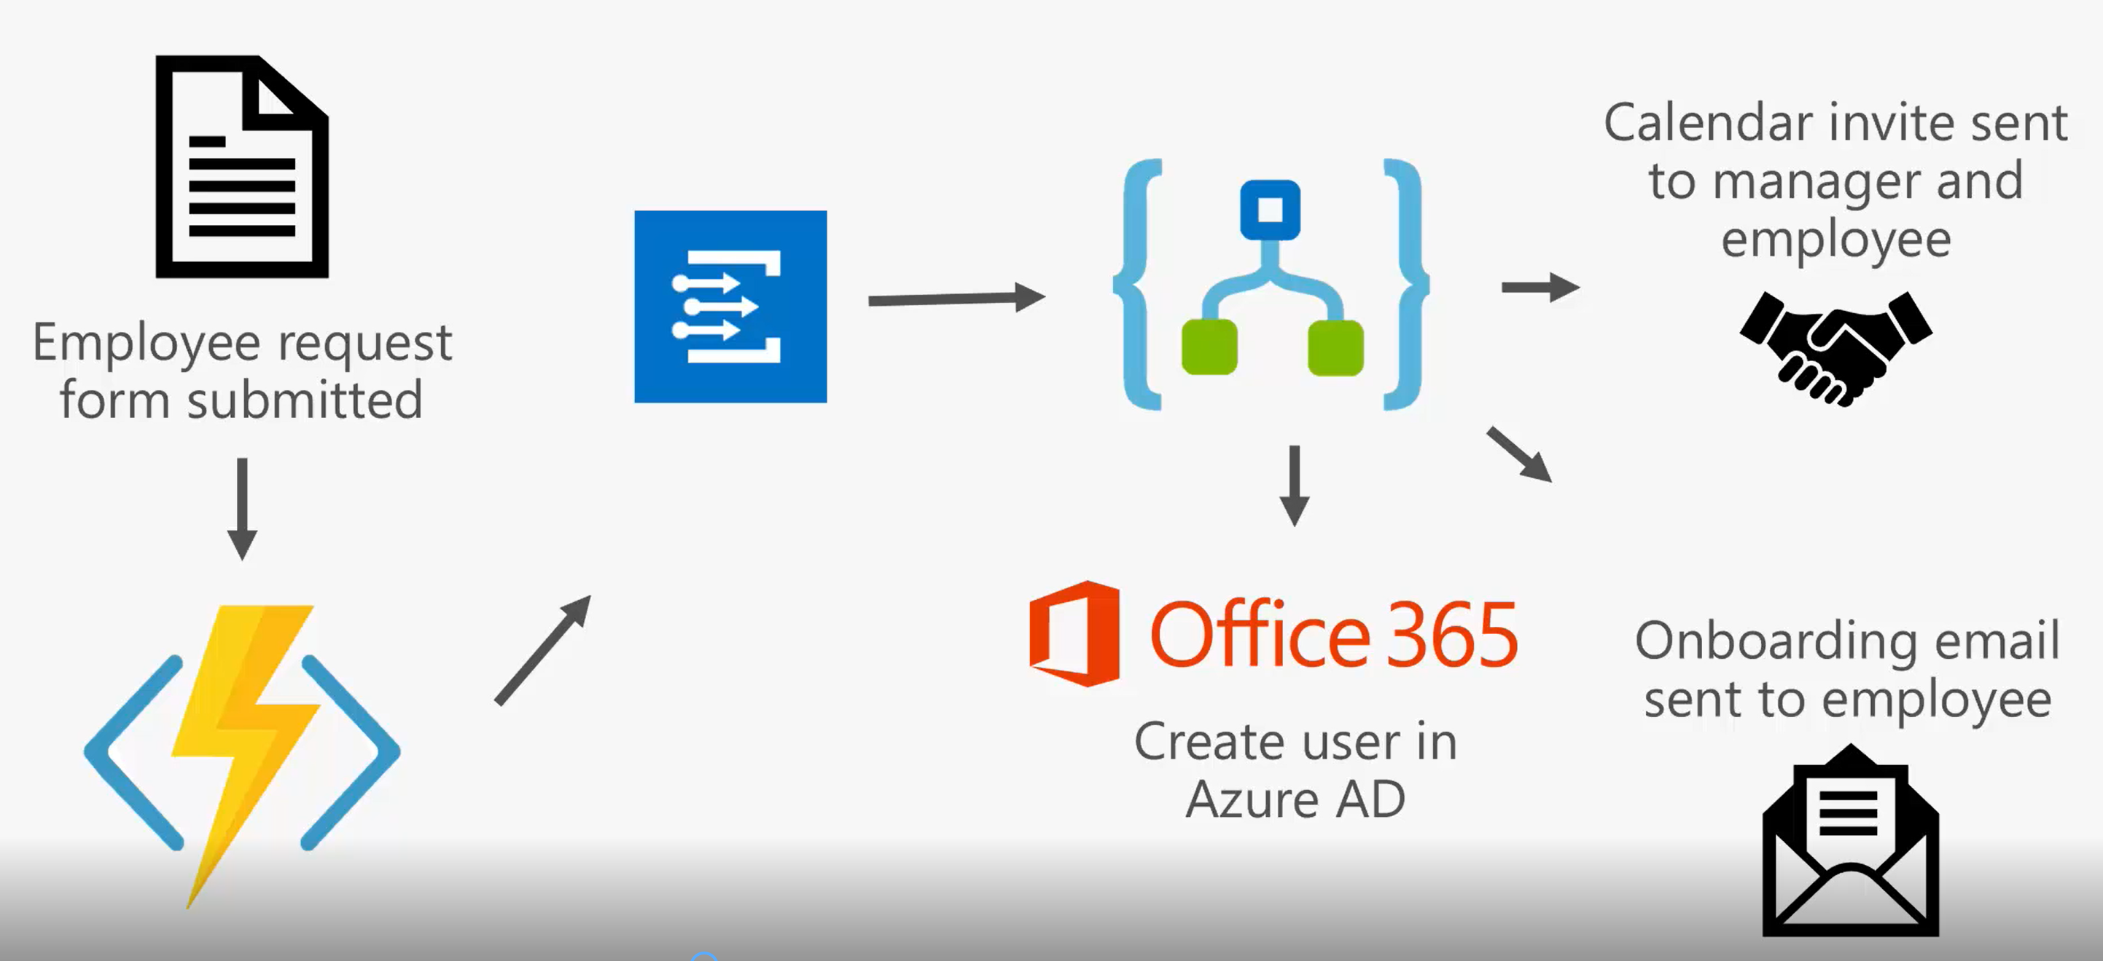
Logic app, functions and event grid together
Notes:
Here we have an employee onboarding scenario…
First an employee request form is submitted to a Function.
The Function processes the form and raises a “new employee” event.
There is an onboarding Logic App that subscribes to new employee events and is triggered.
The logic app proceeds to create the new employee an Account in Azure AD.
It then sends an onboarding email to the new employee welcoming them to the company.
Finally it schedules a meeting between the new employee and their manager.

Slide 24
What’s New With Functions & Logic Apps
Azure Functions
2.0 General Availability
Key Vault Secret Integration
Python private preview
Logic Apps
Isolated Logic Apps (VNet) public preview
Managed identities
Smart designer features

Slide 25
Event Grid Roadmap
Publishers
Compute
KeyVault
Azure Container Registry
Device Provisioning Service
Azure Data Lake Store
Event Domains
Advanced Filters
String
In/Not in
Beings with/Ends with
Contains
Numerical
In/Not In
Greater than/Less than
Greater than or equal/Less than or equal
Boolean

Slide 26
Identity and Authentication
Azure Active Directory
Identity fabric of Azure Resources and Microsoft Graph Entities
Managed identity authentication
Service principal authentication
User-based authentication
Non-Azure AD
API Keys
Anonymous

Slide 27
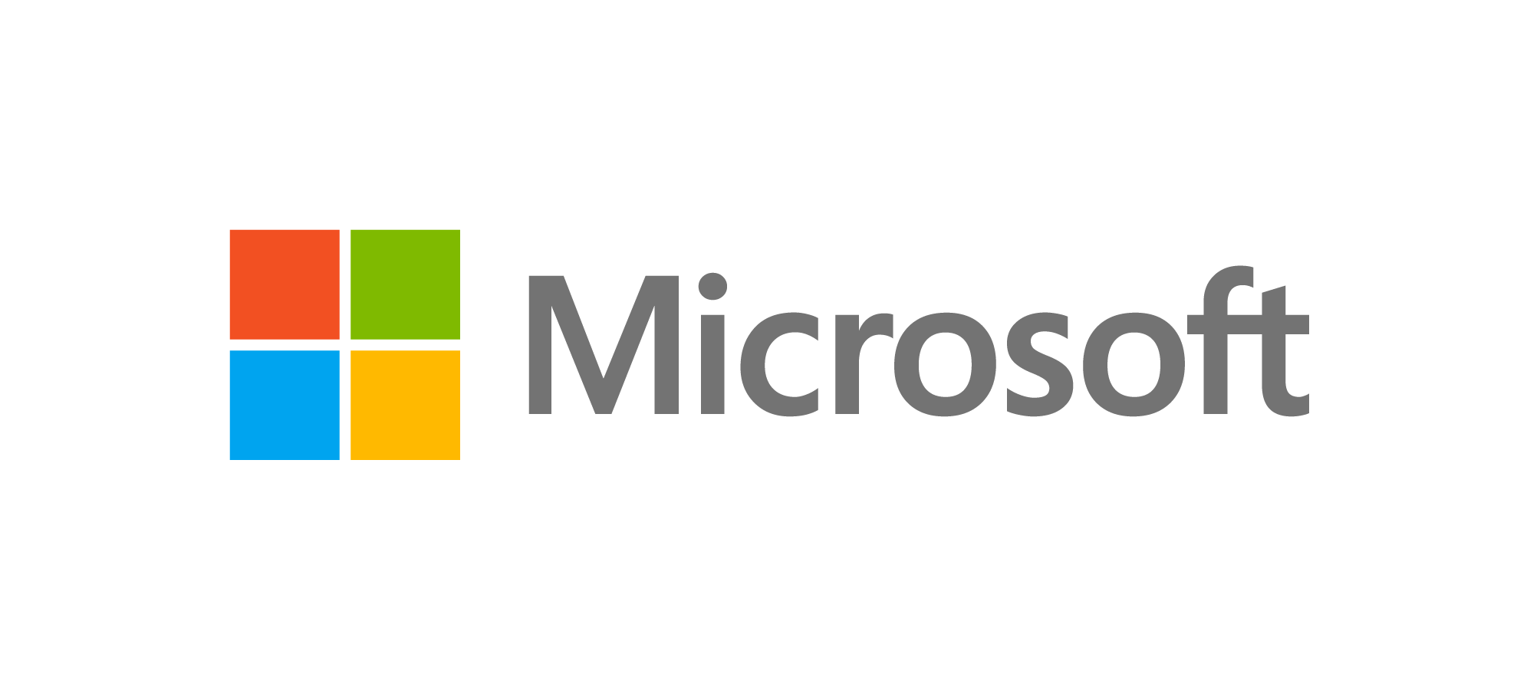

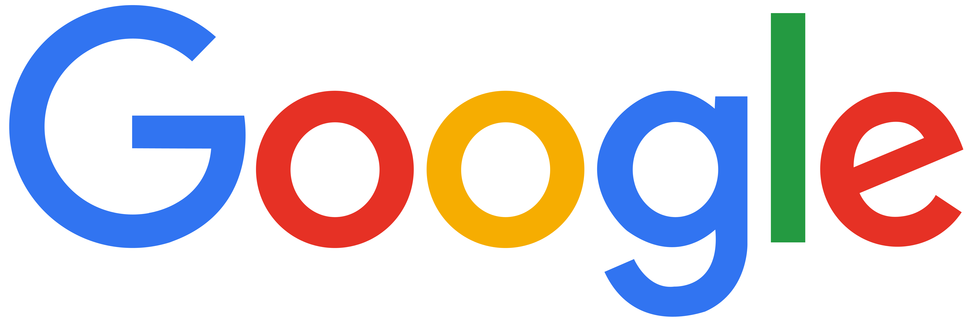

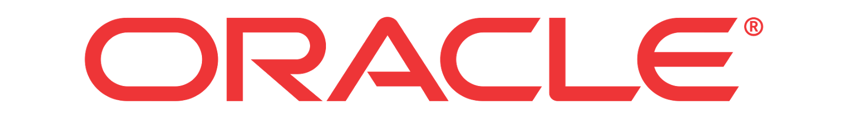
Serverless competitive landscape
 | Functions as a Service | Containers as a Service
 | Azure Functions | Azure Container Instances
 | AWS Lambda | AWS Fargate
 | Cloud Functions | N/A
 | Cloud Functions (based on OpenWhisk) | N/A
 | Fn | N/A
Others | OpenWhisk, OpenFaas and many others. | N/A
Notes:
In addition to leading offerings from Microsoft and Amazon in the Serverless space there are many other competitors in the landscape.
The combination of Serverless, Platform and Container services are rapidly coming together to provide a powerful new cloud-native application platform.

Slide 28
Demo

Slide 29
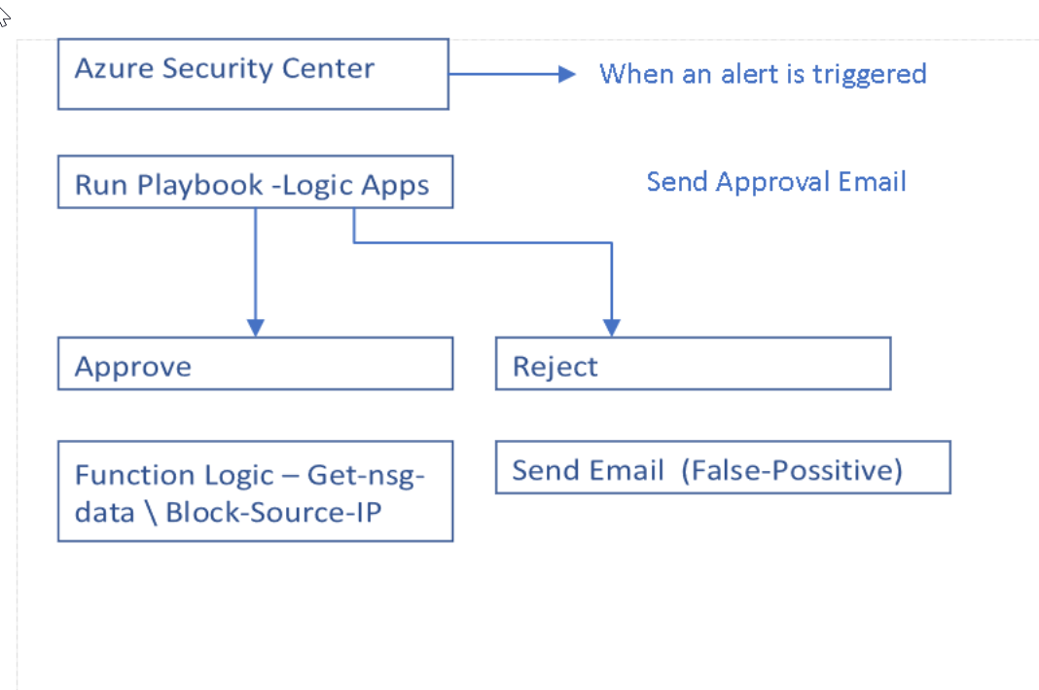
Demo

Slide 30

Review
Notes:
So in this module we talked about:
Serverless is the natural evolution in the trend of abstracting anything not related to app code
We looked at the characteristics and benefits of serverless services.
Azure we have three key services for serverless apps: functions, logic apps and event grid

Slide 31
Characteristics of Serverless services
$
Abstraction of servers and infrastructure
Event-driven/ instant scale
Micro-billing
Notes:
Now we’ve seen briefly how we’ve arrived at the idea of Serverless. Here are the fundamental attributes of Serverless services:
They abstract servers and related infrastructure allowing you to focus on your app.
They accommodate event-driven solutions and automatically scale up and down to meet demand.
They provide usage based billing allowing you to pay only for the resources you use.

Slide 32
Benefits of Serverless solutions
Focus on business logic
Reduced DevOps effort
Faster time to market
Notes:
There are lots of benefits to serverless solutions with the main ones being:
All servers and related infrastructure is completely managed for you allowing you to focus on your app’s business logic.
Because there is no infrastructure to manage the effort on you DevOps team is significantly reduced.
Finally both of the previous points contribute to faster time to market for your app allowing you to differentiate, iterate and improve more quickly.

